Slide 1
Support Vector Machines
Alice Zhao
June 26, 2017

Slide 2
Agenda
SVM Basics
- Visual introduction - Example in Python
Additional Complexities
- Higher dimensions - C parameter
Multiple classes - Kernel trick
Closing Remarks
- Pros and cons - Other techniques

Slide 3
Agenda
SVM Basics
- Visual introduction - Example in Python
Additional Complexities
- Higher dimensions - C parameter
Multiple classes - Kernel trick
Closing Remarks
- Pros and cons - Other techniques

Slide 4
It’s a classification technique.
What is SVM?
Notes:
Simply put, it’s a classification technique. While there many SVM models. It is mainly used as a classification technique. I’ll be visually walking you through the original SVM algorithm that was developed in the ’60s.

Slide 5
Split the data
in the best possible way

Slide 6
Split the data
in the best possible way
Notes:
While it’s a vague request, you intuitively know what to do.

Slide 7
Split the data
in the best possible way

Slide 8
Support
Vector
Machine

Slide 9
Why is this the best split?

Slide 10

Why is this the best split?
This is the widest road that separates the two groups
Notes:
Let’s take a look at the optimal way to split the data. You can think of the line as the median down the road. And then the way to best split the data is to create the widest lanes that you can.

Slide 11
Why is this the best split?
Notes:
How did I create that lane? This lane is as far as possible from both groups of data.

Slide 12
Why is this the best split?
This is the widest road that separates the two groups

Slide 13
Why is this the best split?
This is the widest margin that separates the two groups

Slide 14
Why is this the best split?
margin
The distance between the points and the line are as far as possible
Notes:
In other words, this.

Slide 15
Why is this the best split?
margin
The distance between the support vectors and the line are as far as possible
Notes:
In other words, this.

Slide 16
Why is this the best split?
margin
The distance between the support vectors and the hyperplane are as far as possible
Notes:
In other words, this.

Slide 17
Support
Vector
Machine
hyperplane
support vectors

Slide 18
Split the data
in the best possible way
margin
hyperplane
This hyperplane best splits the data
because it is as far as possible from these support vectors
support vectors
which is another way of saying we maximized the margin
Notes:
So now if I ask you this question again, what will you answer?

Slide 19
How do you maximize the margin?
margin
This is a
constrained
optimization
problem
which can be solved using the Lagrange Multipliers technique
(details in Appendix)
Notes:
Maximize an objective function under a constraint

Slide 20
It was called the “Maximal Margin Classifier”
We just visually reviewed the original SVM concept that was invented in 1963

Slide 21
Let’s apply this to a real world problem.
So now what?

Slide 22
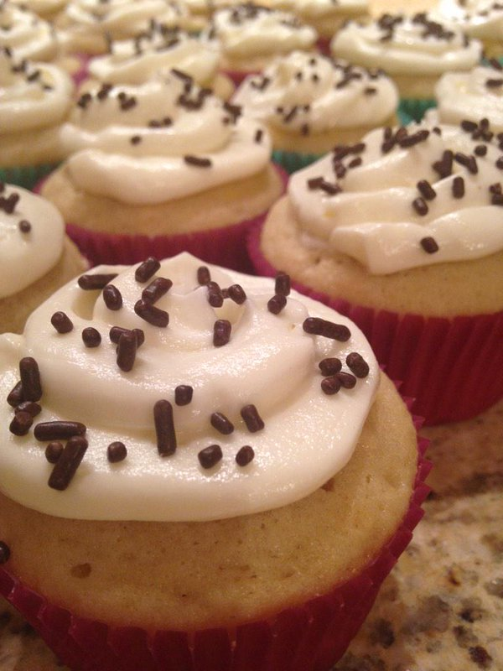
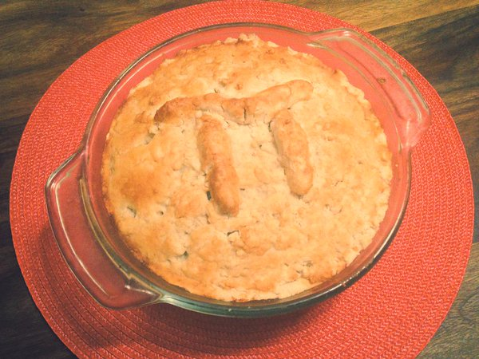
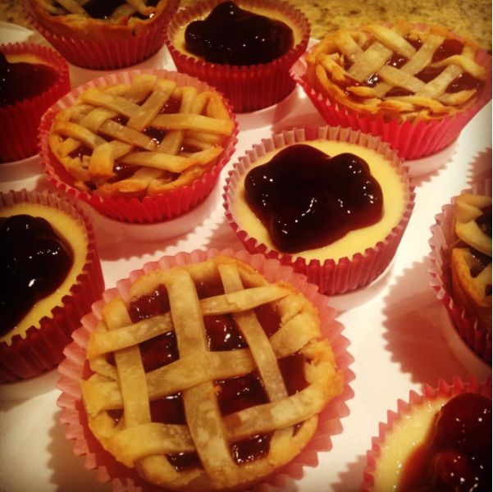
My other passion (second to data science, of course!)
Notes:
I love to bake

Slide 23
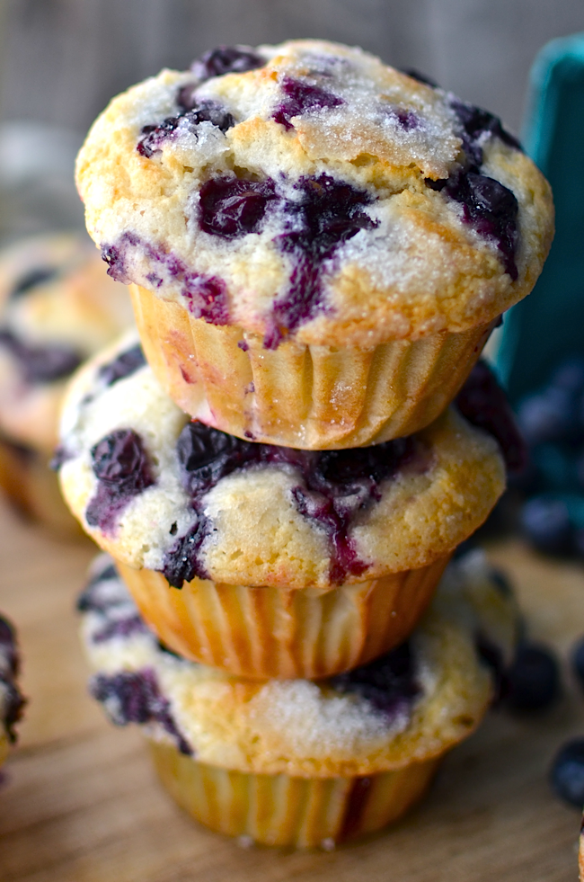
Cupcakes
Muffins
versus
“a cupcake is just a muffin with frosting”
“a muffin is just a cupcake with random bits of stuff in it”
Notes:
Every time I bake muffins, my husband always says, cupcakes and muffins are the same thing! When I told him I would be using this data set for my SVM example, he didn’t believe it would work, but spoiler alert – it did!

Slide 24
Cupcakes vs Muffins
The Challenge
Classify recipes as cupcakes or muffins. When given a new recipe, determine if it’s a cupcake or a muffin.
The Steps
Find the data
Apply a data science model
Review the results

Slide 25
Cupcakes vs Muffins
The Challenge
Classify recipes as cupcakes or muffins. When given a new recipe, determine if it’s a cupcake or a muffin.
The Steps
Find the data
Apply a data science model
Review the results

Slide 26

1. Find the data
Recorded the top 10 muffin and top 10 cupcake recipes
Recipe | Flour | Sugar | Butter | Milk | Egg | Baking Powder | Salt | Vanilla
Muffin1 | 2 cups | 1/2 cup | 1/4 cup | 1 cup | 2 eggs | 1 tbsp | 1/2 tsp | 1 tsp
Cupcake1 | 2 cups | 3/4 cup | 1/2 cup | 1 cup | 2 eggs | 2 tsp | 1/2 tsp | 1 tsp
… | … | … | … | … | … | … | … | …

Slide 27
1. Find the data
Problem
Each recipe yields different amounts of batter
Solution
Amount-based Percent-based
Recipe | Flour | Sugar | Other
Muffin1 | 2 cups | 1/2 cup | …
Cupcake1 | 2 cups | 3/4 cup | …
Recipe | Flour | Sugar | Other | Total Volume
Muffin1 | 47% | 24% | … | 100%
Cupcake1 | 42% | 21% | … | 100%
Notes:
To normalize the data

Slide 28
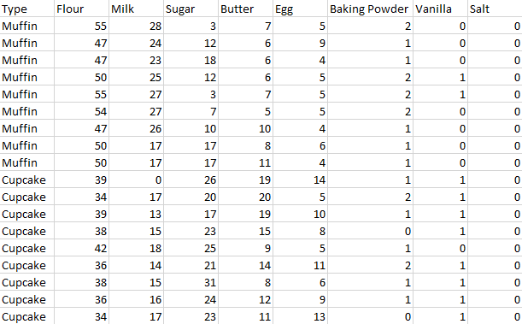
1. Find the data

Slide 29
Cupcakes vs Muffins
The Challenge
Classify recipes as cupcakes or muffins. When given a new recipe, determine if it’s a cupcake or a muffin.
The Steps
Find the data ✓
Apply a data science model
Review the results

Slide 30
Cupcakes vs Muffins
The Challenge
Classify recipes as cupcakes or muffins. When given a new recipe, determine if it’s a cupcake or a muffin.
The Steps
Find the data ✓
Apply a data science model
Review the results

Slide 31
1. Apply a data science model
The Challenge
Classify recipes as cupcakes or muffins. When given a new recipe, determine if it’s a cupcake or a muffin.
The Solution
Use a classification technique → SVM
Use a statistical tool to create the model → Python

Slide 32
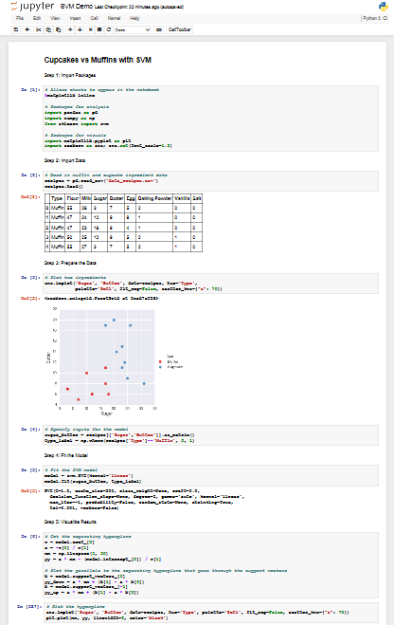
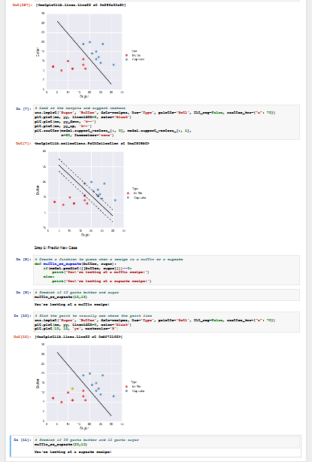
Python Script
Import Libraries
Import Data
Prepare the Data
Fit the Model
Visualize Results
Predict New Case

Slide 33
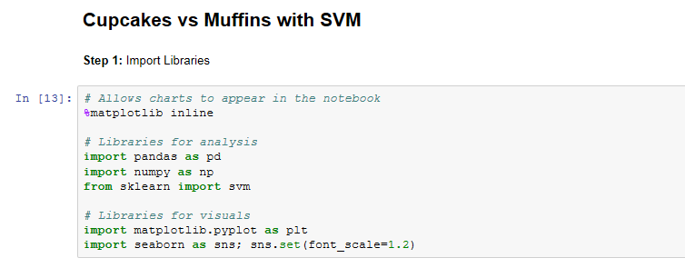
a. Import Libraries

Slide 34
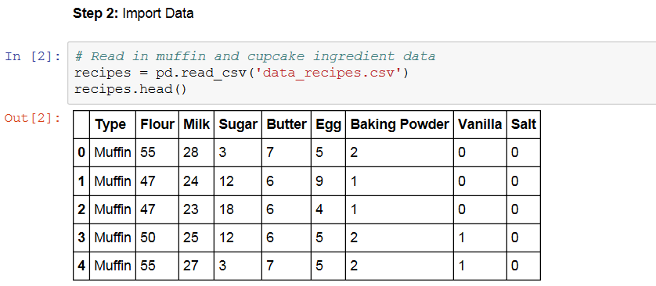
b. Import Data

Slide 35
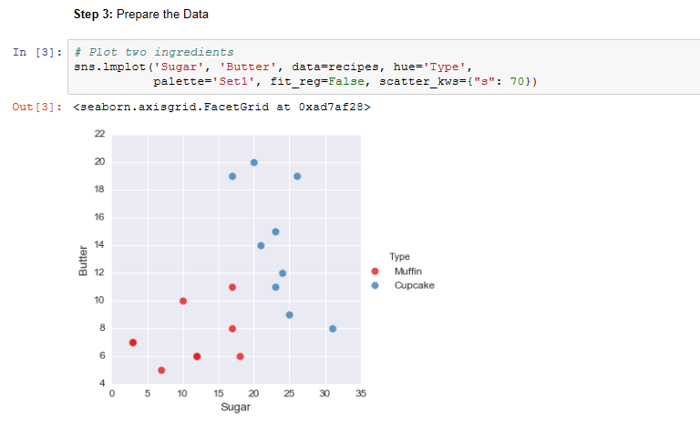
c. Prepare the Data

Slide 36
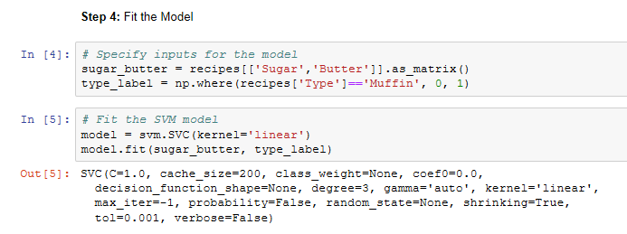
d. Fit the Model

Slide 37
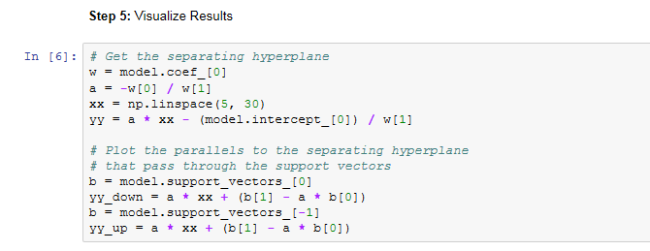
e. Visualize Results

Slide 38
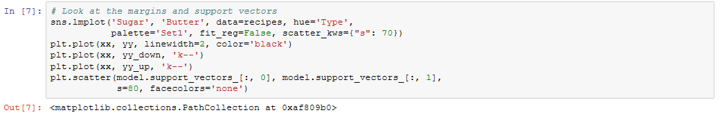
e. Visualize Results

Slide 39
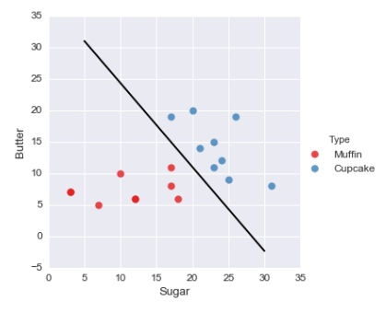
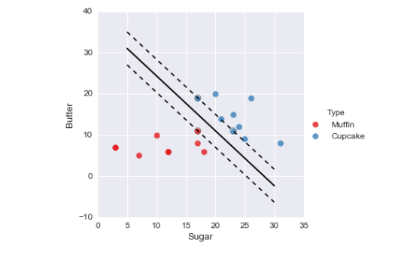
e. Visualize Results
Our SVM Model

Slide 40
Cupcakes vs Muffins
The Challenge
Classify recipes as cupcakes or muffins. When given a new recipe, determine if it’s a cupcake or a muffin.
The Steps
Find the data ✓
Apply a data science model ✓
Review the results

Slide 41
Cupcakes vs Muffins
The Challenge
Classify recipes as cupcakes or muffins. When given a new recipe, determine if it’s a cupcake or a muffin.
The Steps
Find the data ✓
Apply a data science model ✓
Review the results

Slide 42
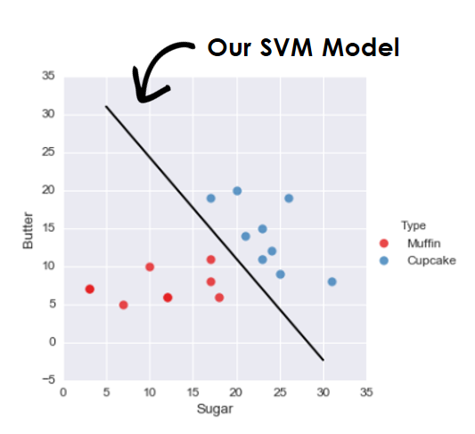

3. Review the Results
The Challenge
Classify recipes as cupcakes or muffins. ✓
When given a new recipe, determine if it’s a cupcake or a muffin.

Slide 43
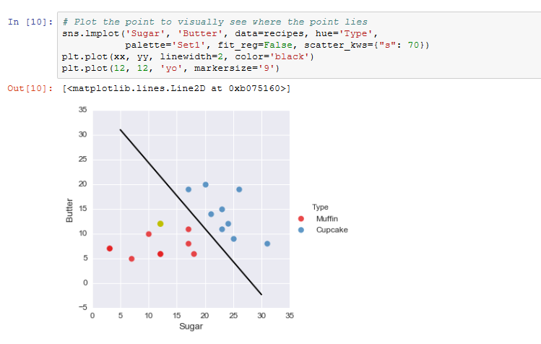
f. Predict New Case

Slide 44
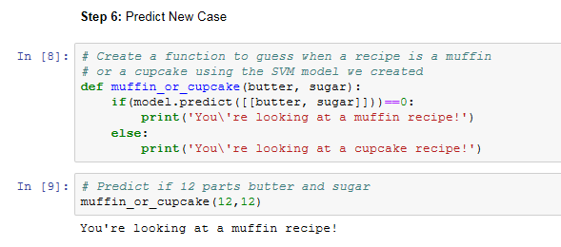
f. Predict New Case

Slide 45
Cupcakes vs Muffins
The Challenge
Classify recipes as cupcakes or muffins. When given a new recipe, determine if it’s a cupcake or a muffin.
The Steps
Find the data
Apply a data science model
Review the results ✓

Slide 46
Cupcakes
Muffins
versus
Cupcakes and muffins can be classified using Support Vector Machines!
“a cupcake is just a muffin with frosting”
“a muffin is just a cupcake with random bits of stuff in it”

Slide 47
Up next: How to make SVM even more powerful
Basic case ✓

Slide 48
Agenda
SVM Basics
- Visual introduction - Example in Python
Additional Complexities
- Higher dimensions - C parameter
Multiple classes - Kernel trick
Closing Remarks
- Pros and cons - Other techniques

Slide 49
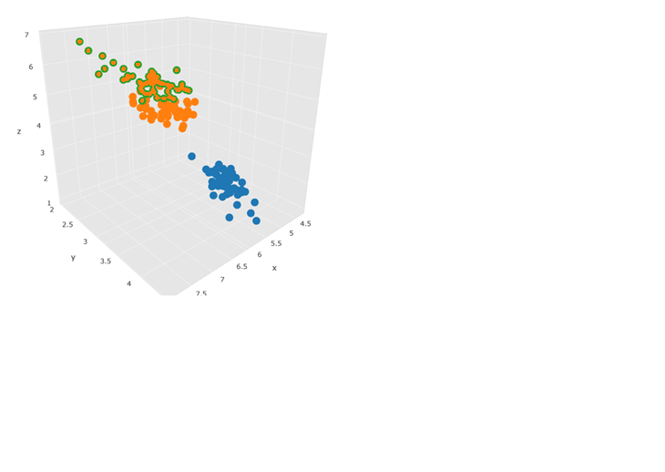
Higher Dimensions: Visual
2D: Separate
with Line
3D: Separate
with Plane
4D+: Hard to Visualize
?
Higher Dimensions C Parameter Multiple Classes Kernel Trick
Notes:
https://help.plot.ly/excel/3d-scatter-plots/

Slide 50
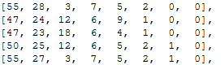
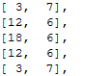
Higher Dimensions: Code
Hard to visualize, but easy to code
With additional ingredients, we have the opportunity to find a wider margin
# Fit SVM model for sugar & butter
model = svm.SVC(kernel='linear')
model.fit(sugar_butter, type_label)
all_ingredients
…
…
Higher Dimensions C Parameter Multiple Classes Kernel Trick

Slide 51
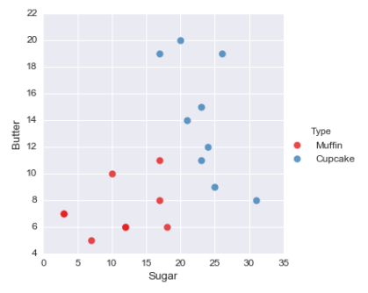
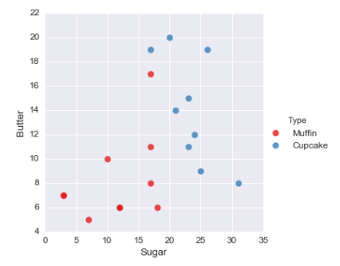
C Parameter: Visual
Demo Data
Original Data
Misclassification
Higher Dimensions C Parameter Multiple Classes Kernel Trick

Slide 52
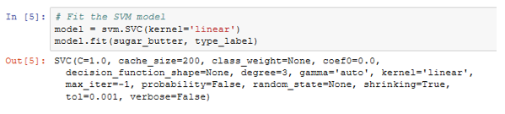
C Parameter: Code
The C parameter allows you to decide how much you want to penalize misclassified points
Default Value
Higher Dimensions C Parameter Multiple Classes Kernel Trick
Notes:
Small C: Prioritizes large margin → more misclassification
Large C: Prioritizes less misclassification → small margin

Slide 53
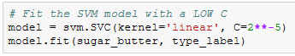
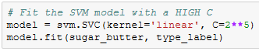
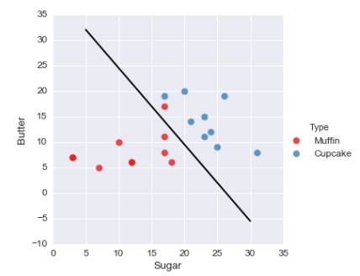
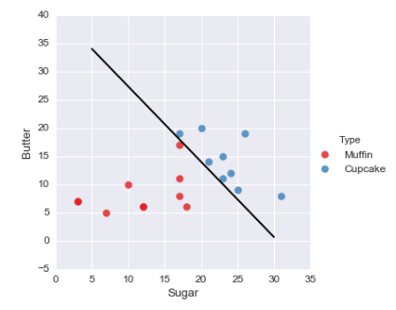
C Parameter: Comparison
Low C:
Prioritize simplicity (soft margin)
High C:
Prioritize making few mistakes
Higher Dimensions C Parameter Multiple Classes Kernel Trick
Notes:
What’s better? It depends. You just need to test it out. Keep on going after testing out 12 and 12.

Slide 54
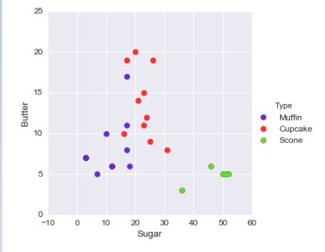
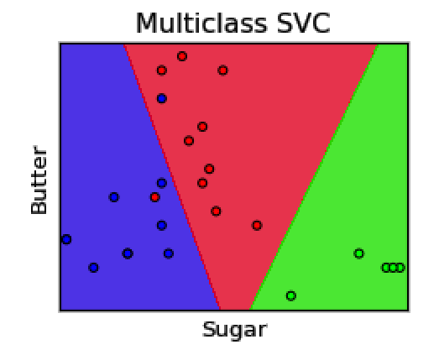
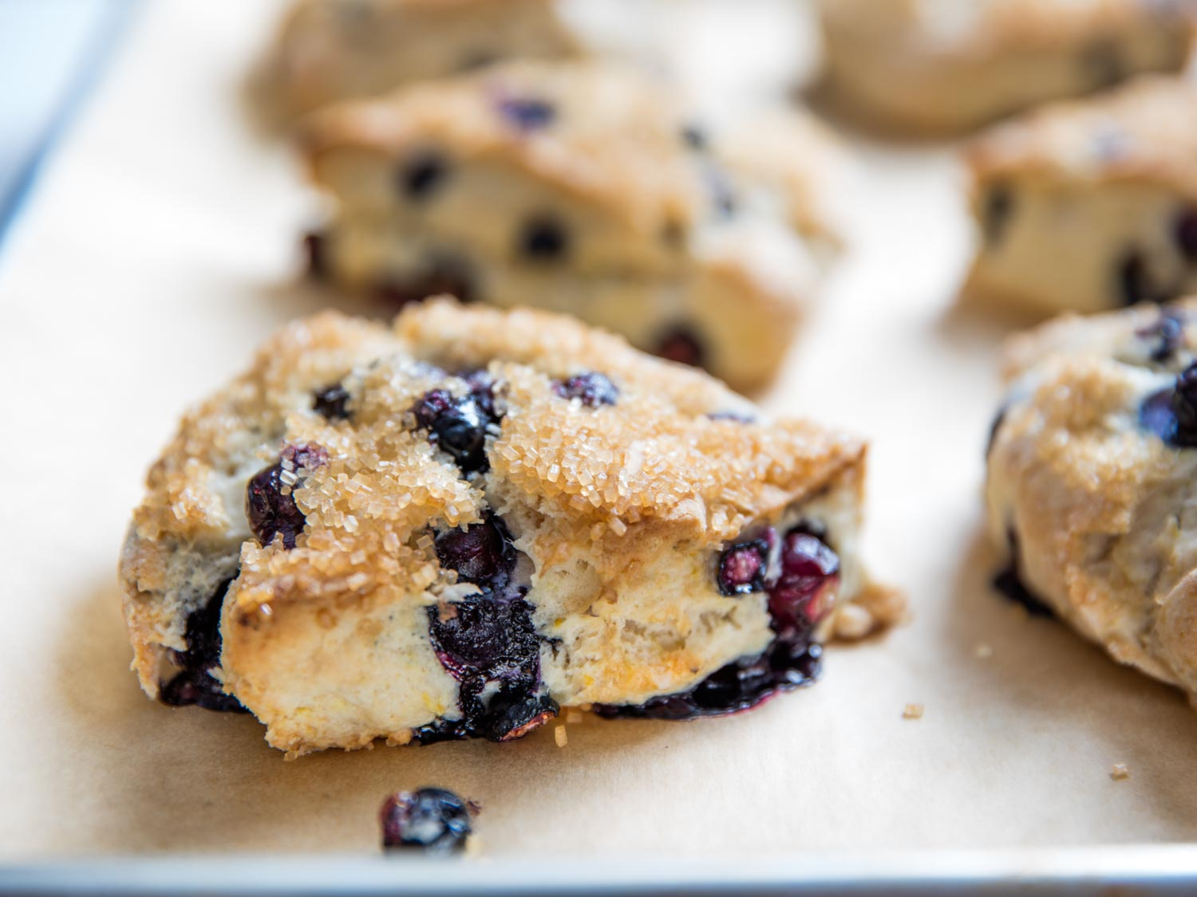
Multiple Classes: Visual
Higher Dimensions C Parameter Multiple Classes Kernel Trick

Slide 55
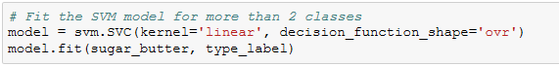
Multiple Classes: Code
Original Code
(2 classes)
Updated Code
(3+ classes)
Higher Dimensions C Parameter Multiple Classes Kernel Trick

Slide 56
Multiple Classes: Comparison
OVR: One vs Rest
OVO: One vs One
Pros: Fewer classifications
Cons: Classes may be imbalanced
Pros: Less sensitive to imbalance
Cons: More classifications
Higher Dimensions C Parameter Multiple Classes Kernel Trick
Notes:
Run 45 times. Used to do OVO, now OVR.

Slide 57
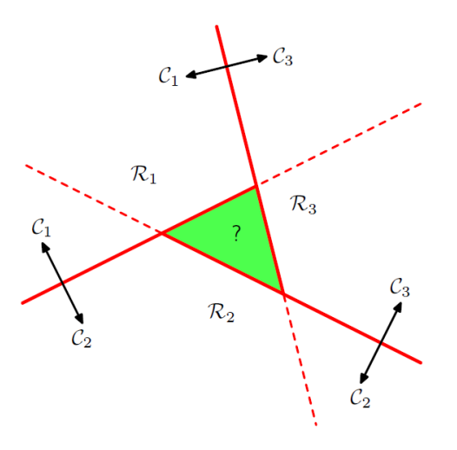
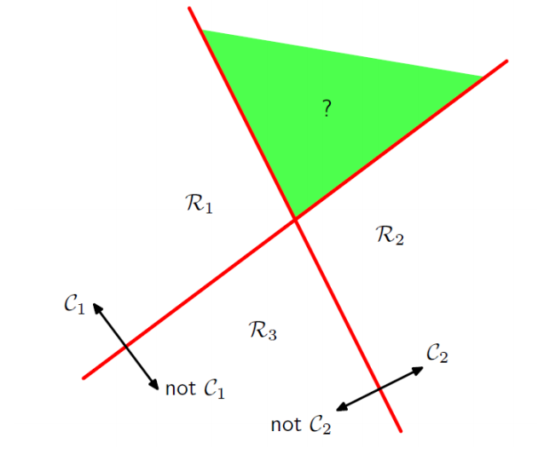
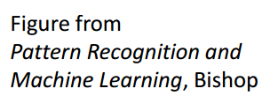
Multiple Classes: Comparison
OVR: One vs Rest
OVO: One vs One
Higher Dimensions C Parameter Multiple Classes Kernel Trick
Notes:
https://www.cs.princeton.edu/courses/archive/spring16/cos495/slides/ML_basics_lecture7_multiclass.pdf

Slide 58
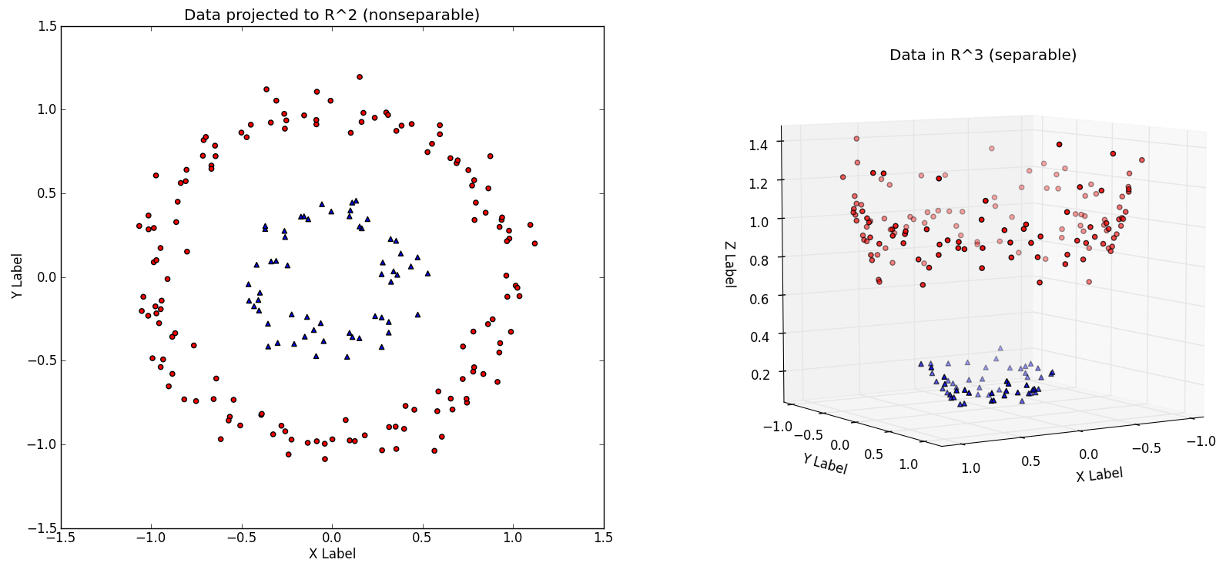
Kernel Trick: Visual
Kernel
Kernel Options
Linear
Radial Basis Function
Polynomial
Sigmoid
Higher Dimensions C Parameter Multiple Classes Kernel Trick
Notes:
http://www.eric-kim.net/eric-kim-net/posts/1/kernel_trick.html
[x, y, x²+y²]

Slide 59
Kernel Trick: Visual
Kernel
Kernel Options
Linear
Radial Basis Function
Polynomial
Sigmoid
Higher Dimensions C Parameter Multiple Classes Kernel Trick
Notes:
http://www.eric-kim.net/eric-kim-net/posts/1/kernel_trick.html
[x, y, x²+y²]

Slide 60
Kernel Trick: Code
Original Code
(linear)
Updated Code
(RBF)
Higher Dimensions C Parameter Multiple Classes Kernel Trick
Notes:
Other kernels. Polynomial and sigmoid.
How do you choose the best? Grid search.

Slide 61
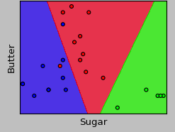
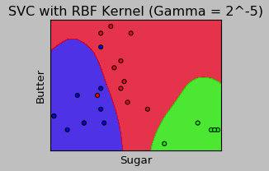
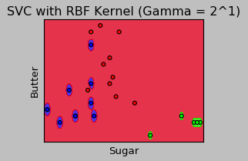
Kernel Trick: Comparison
Kernel: Linear
C: 1
Kernel: RBF
C: 1
Gamma: 2^-5
Kernel: RBF
C: 1
Gamma: 2^1
Small Gamma:
Less complexity
Large Gamma:
More complexity
Higher Dimensions C Parameter Multiple Classes Kernel Trick
Notes:
RBF kernel viz: https://www.youtube.com/watch?v=xWK6G-ub1dY
Trick:

Slide 62
SVM Summary
Higher Dimensions
Instead of fitting the model on only two ingredients, you can easily fit it on many more in Python
4. Kernel Trick
If the data cannot be split linearly, a kernel can transform the data into a higher dimensional space so that it can be split
2. C Parameter
If a hyperplane can’t perfectly split the data, you can tune this parameter to account for misclassification
3. Multiple Classes
SVM can classify data into more than two groups

Slide 63
Agenda
SVM Basics
- Visual introduction - Example in Python
Additional Complexities
- Higher dimensions - C parameter
Multiple classes - Kernel trick
Closing Remarks
- Other techniques - Pros and cons

Slide 64
Agenda
SVM Basics
- Visual introduction - Example in Python
Additional Complexities
- Higher dimensions - C parameter
Multiple classes - Kernel trick
Closing Remarks
- Pros and cons - Other techniques

Slide 65
Up next: When should you use SVM?
SVM overview ✓

Slide 66
Pros and Cons of SVM
Pros
Good at dealing with high dimensional data
Works well on small data sets
Cons
Picking the right kernel and parameters can be computationally intensive

Slide 67
Classification Techniques
SVM is one of many classification techniques
Logistic Regression
K Nearest Neighbors
Decision Trees
Naïve Bayes
Neural Networks
Advice: try multiple techniques on your data set
Notes:
One more for your tool kit. Different techniques used at different times for different data sets.

Slide 68
Agenda
SVM Basics
- Visual introduction - Example in Python
Additional Complexities
- Higher dimensions - C parameter
Multiple classes - Kernel trick
Closing Remarks
- Pros and cons - Other techniques

Slide 69
Thank You!
Support Vector Machines

Slide 70
The Math Behind Maximizing the Margin
Appendix

Slide 71
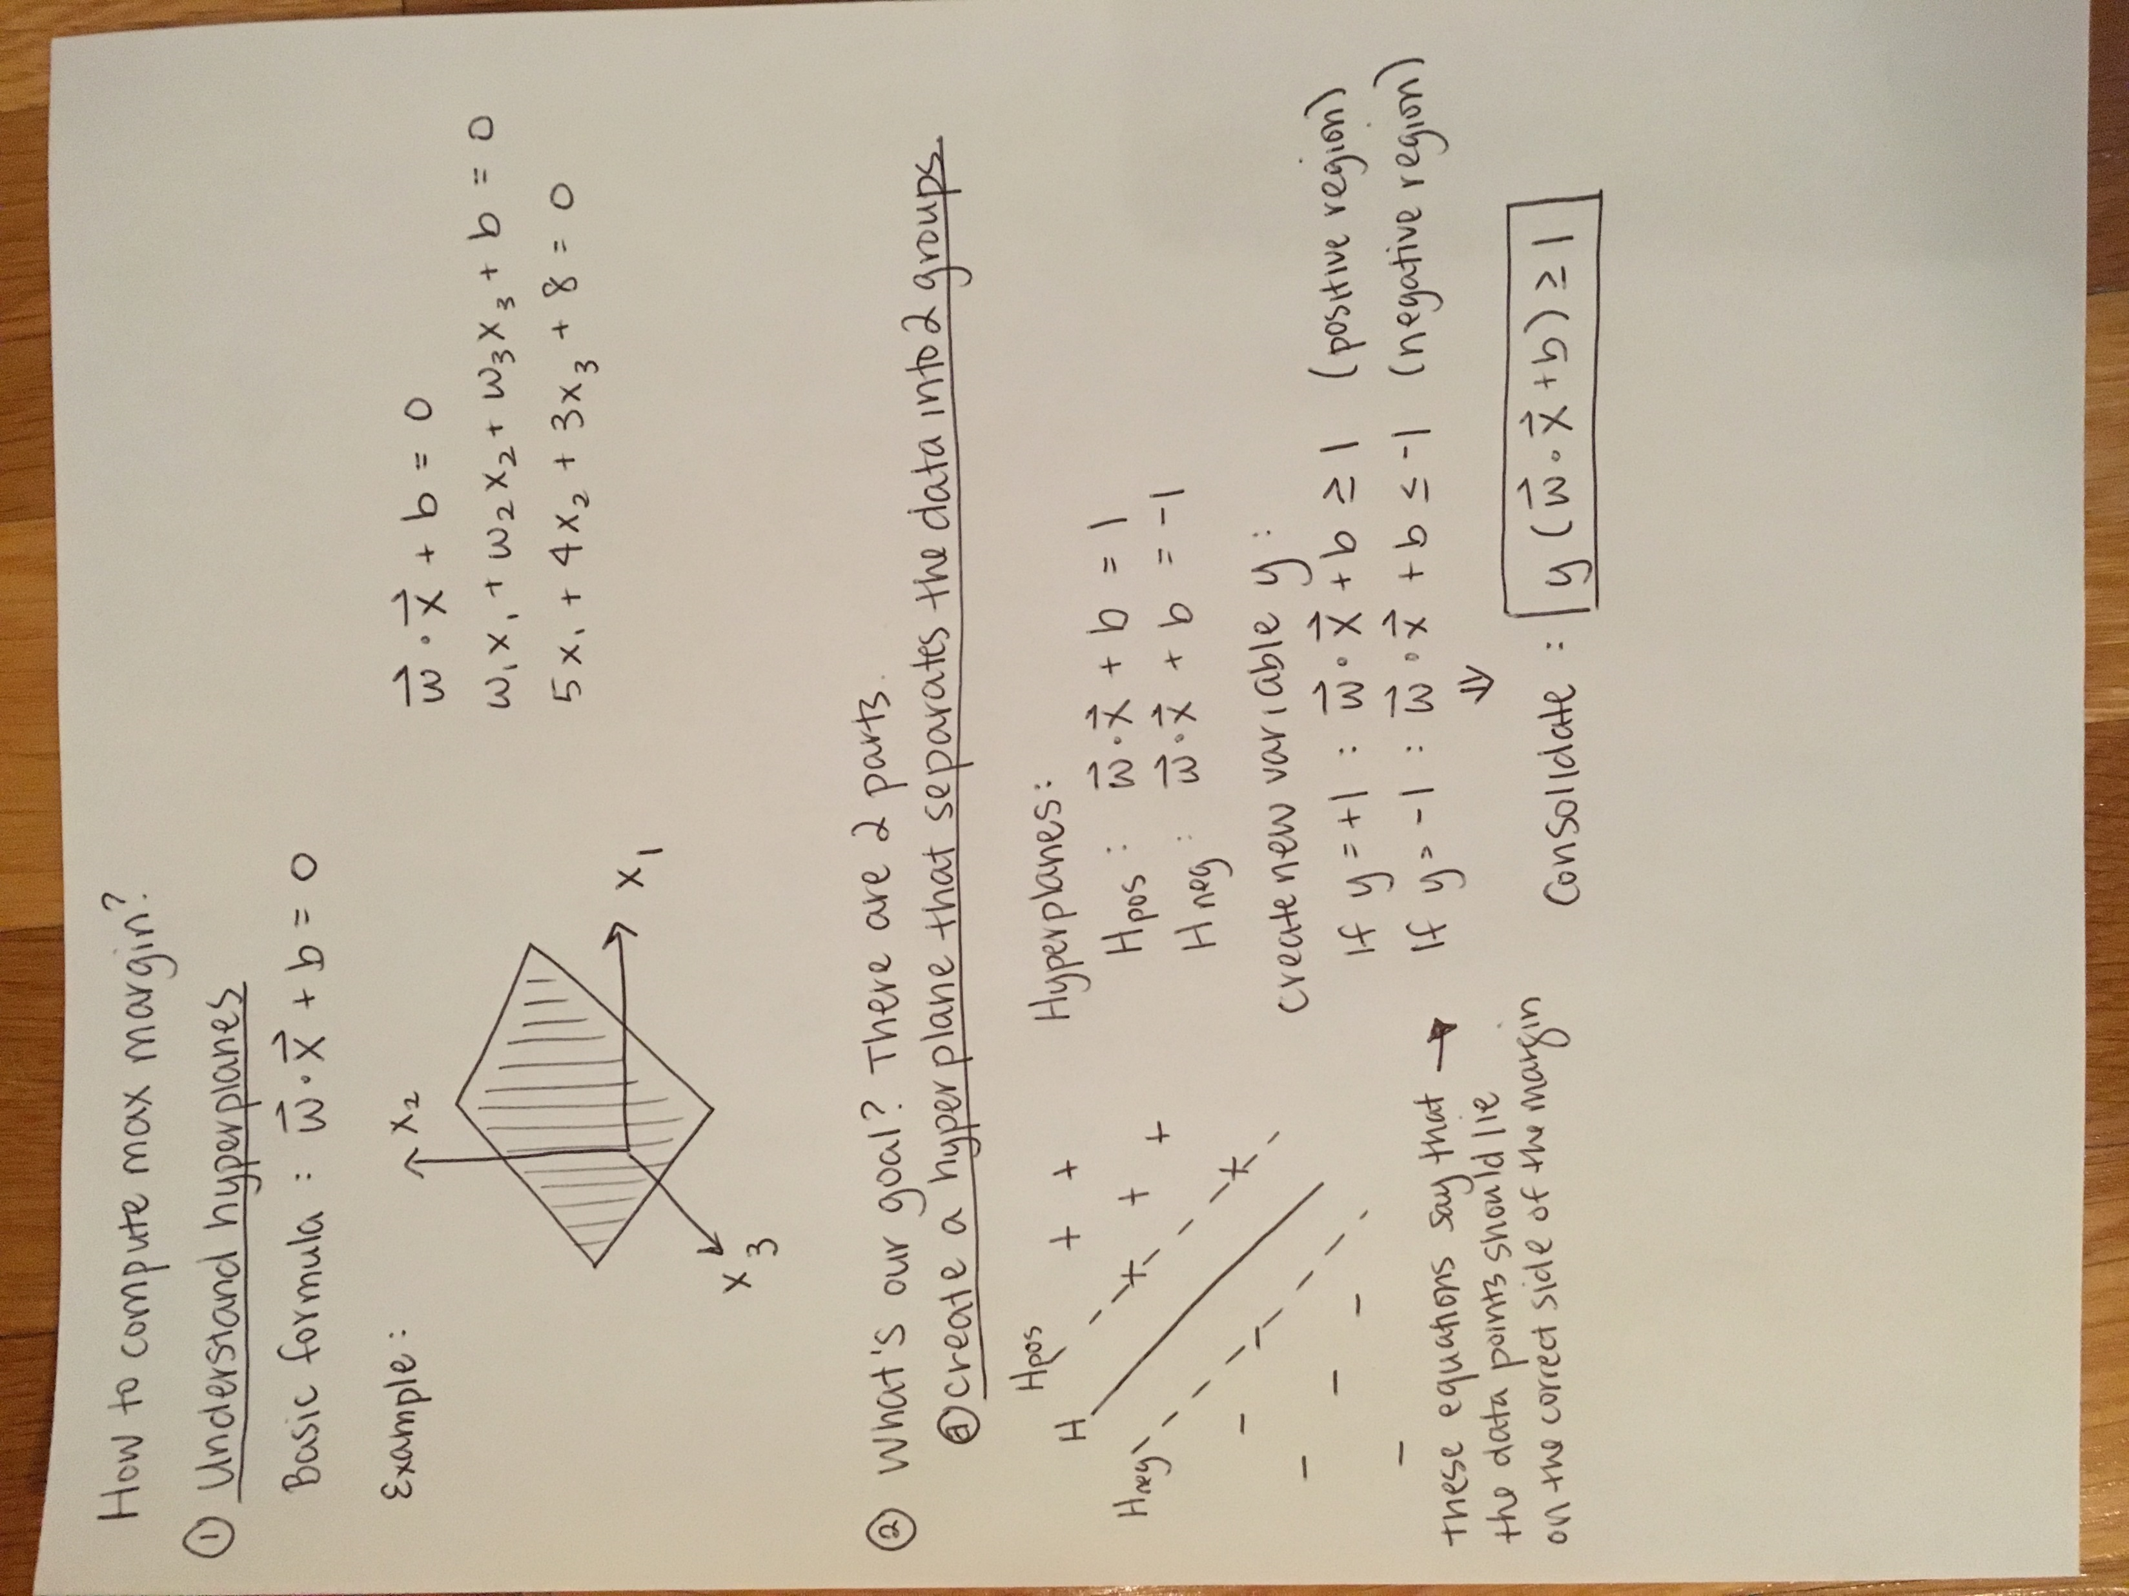
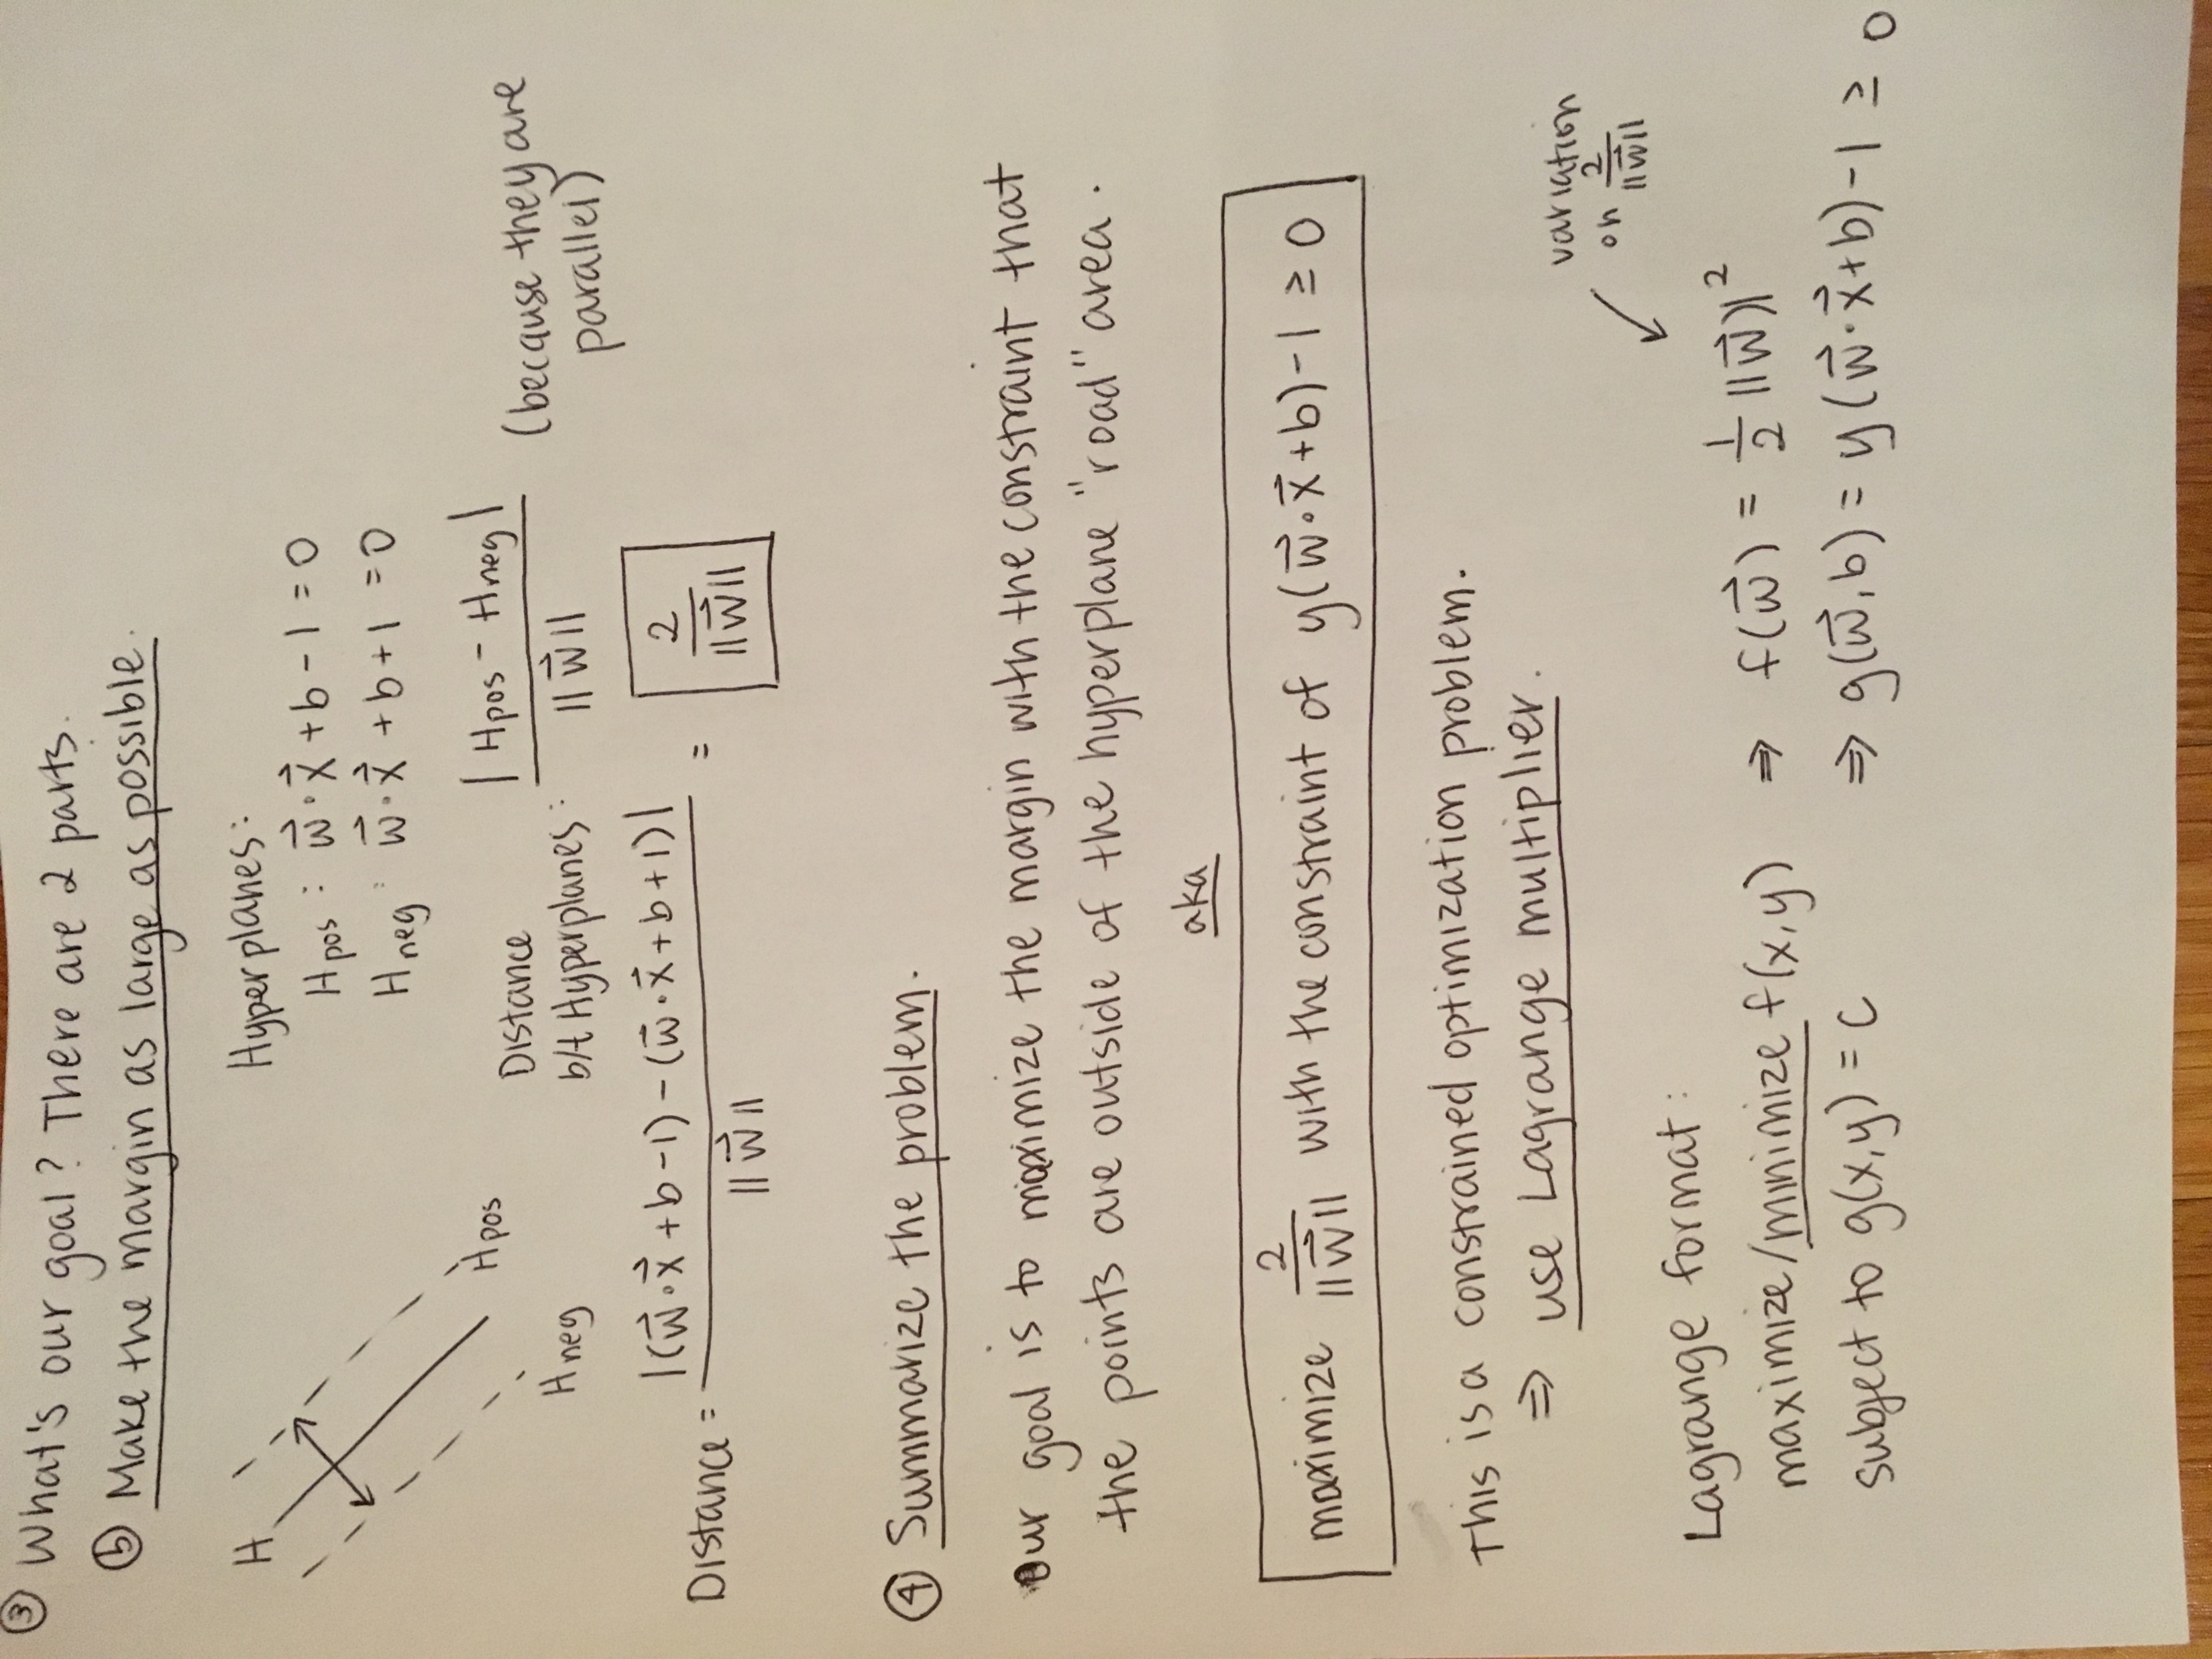

Slide 72
